Slide 2
Introduction to IoT

Slide 3
What is IoT (Internet of Things)
At its core, the Internet of Things (IoT) is a concept that refers to the interconnection of everyday objects and devices to the internet. These objects can collect and exchange data, making them “smart” and capable of improving efficiency, convenience, and decision-making.
IoT devices are a combination of hardware and software. Hardware components are a set of elements that connect in a particular manner. For example, consider a breadboard. We have microcontrollers, LEDs, voltage regulators, resistors, capacitors and various other things. All of these are hardware components that are wired together.

Slide 4
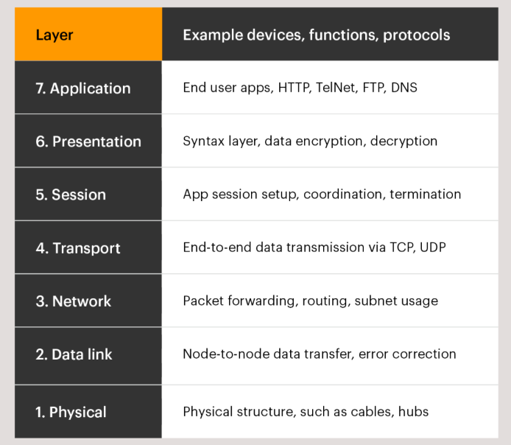
OSI Model

Slide 5
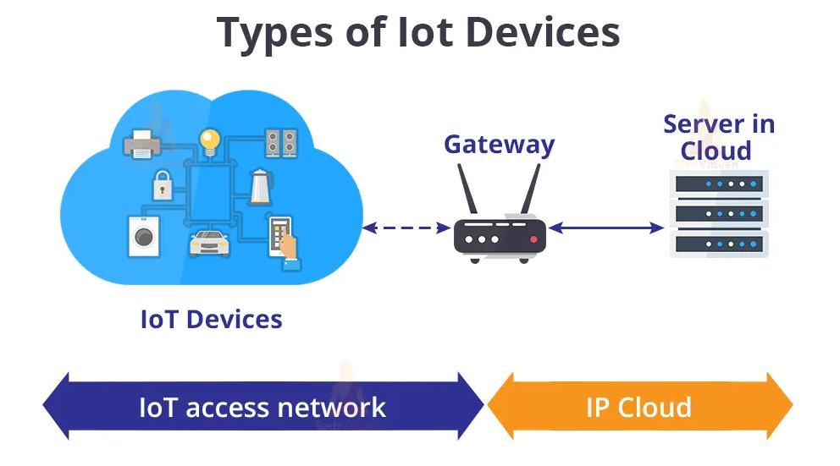
Types of IoT devices

Slide 6
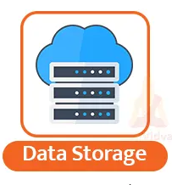
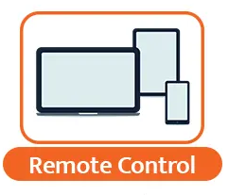
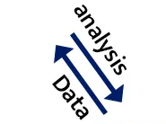
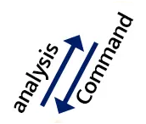
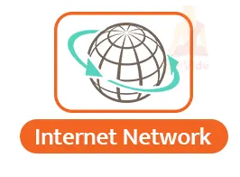
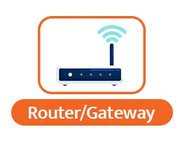
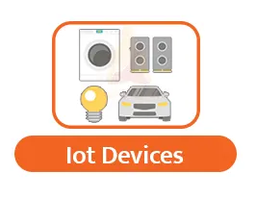


How does IoT devices Operators?
6

Slide 7
Key Features of IoT
Highly adaptable and reliable
IoT devices may not necessarily have IP addresses.
IoT devices consume less power compared to standard computers and desktops.
Through IoT, appliances can connect and communicate with each other.

Slide 8
Advantages of IoT
Technical Optimization:
With the improvisation of data transfer, we are in a way also optimizing the devices. IoT introduces us to much more functional and progressive technology.
Modified Data collection:
In the old days, it took days or even months to transfer data and to store data. IoT made it possible to transfer and retrieve data from any part of the world in milliseconds.
Waste reduction:
Older methodologies take time to notify users in case of dangers and emergencies but IoT sends alerts and notifications before the situation escalates. This helps in saving money and energy.
Better Customer service:
Since the devices can interact with each other, customers can optimize and modify their home appliances according to their needs and this improves the customer experience with any IoT brand.

Slide 9
Disadvantages of IoT
Even though IoT has thousands of advantages and can transform the way we live, it comes with its setbacks. Scientists and researchers are working on these setbacks to improve the technology. Some of the most common disadvantages are:
Security:
IoT data is exposed to hackers and it is vulnerable
Privacy:
IoT stores our data on cloud servers located miles away from the end clients, this means the user may have to compromise on their privacy.
Flexibility:
IoT devices have a complicated integration system and it gets difficult to access locked devices during an emergency.
Complexity:
IoT introduces a wide range of technologies that have dozens of complex design patterns and tracks.
Compliance:
IoT has a wide range of regulations as compared to other technologies. IoT devices and software must comply with these rules for proper functioning.

Slide 10
Challenges of IoT
Inadequate testing and updating
Threat to user data privacy and security
Complex software functionality
Interpreting large amounts of data
AI and automation integration
IoT devices need access to constant power supply
Short-range communication and connectivity

Slide 11
Best practices of IoT
Track and manage IoT devices
Assess your endpoints in the networks
Understand your security and privacy regulations
Conduct tests and experiments before launching the setup
Changes passwords and credentials regularly

Slide 12
Applications of IoT
The most common IoT applications are:
Smart cities
Smart grid
Smart cars
Smart homes
Smart retail
Smart Healthcare
Industrial automation
Wearables
Smart farming
Smart pollution control

Slide 13
Thank you !

